Slide 1
To-Do List Web Application
Syed Mahian

Slide 2
Agenda
Concept
Sprint Plan
Consultant’s Journey
CI
Testing
Demonstration
Sprint Review
Sprint Retrospective
Conclusion

Slide 3
Concept
To create a To-Do List Web-Application that has CRUD functionalities for both Users and Tasks

Slide 4
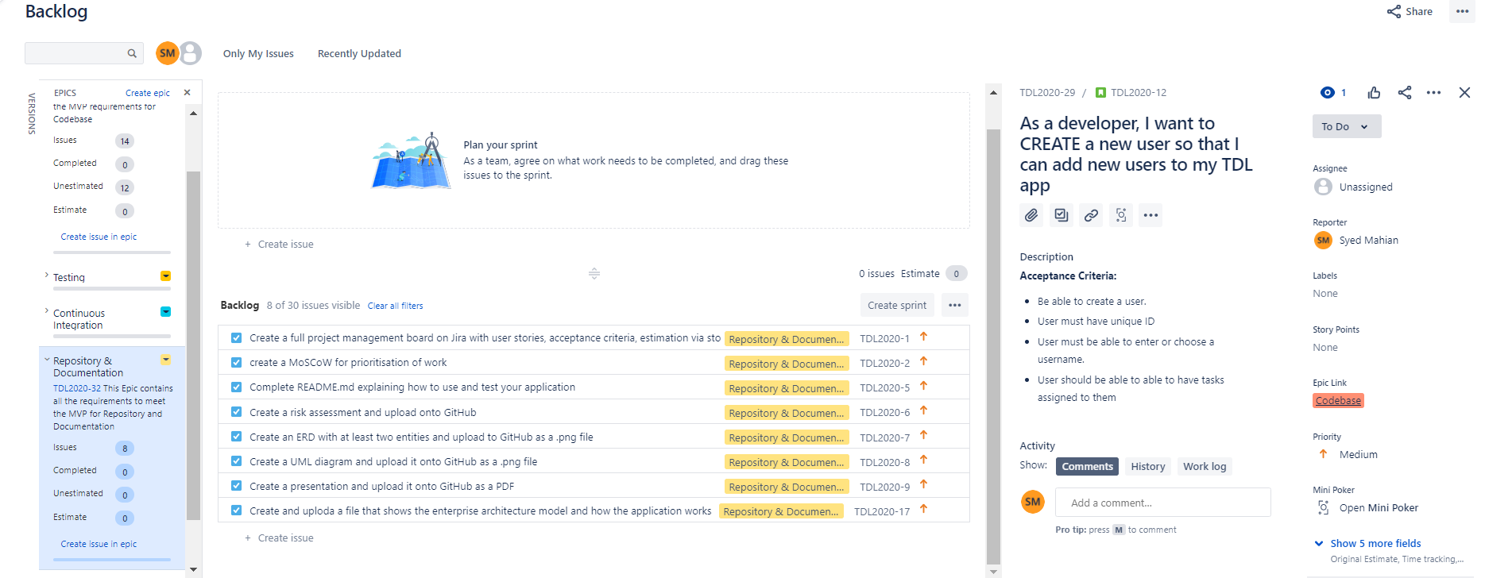
Sprint Plan

Slide 5
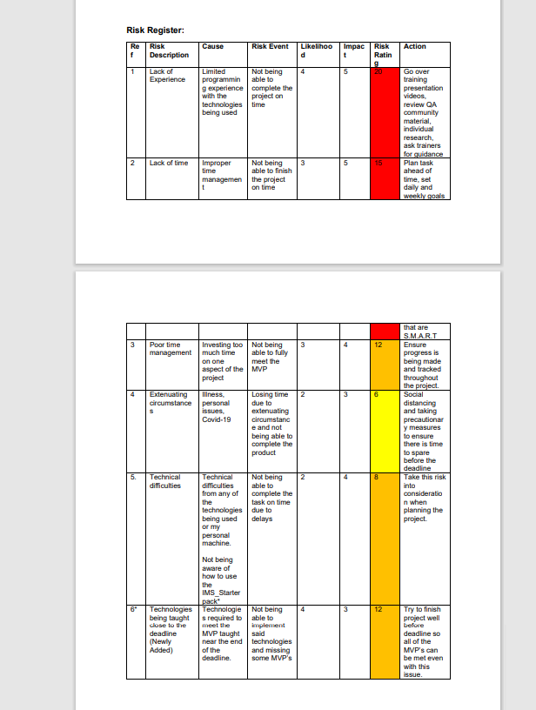
Risk Assessment

Slide 6
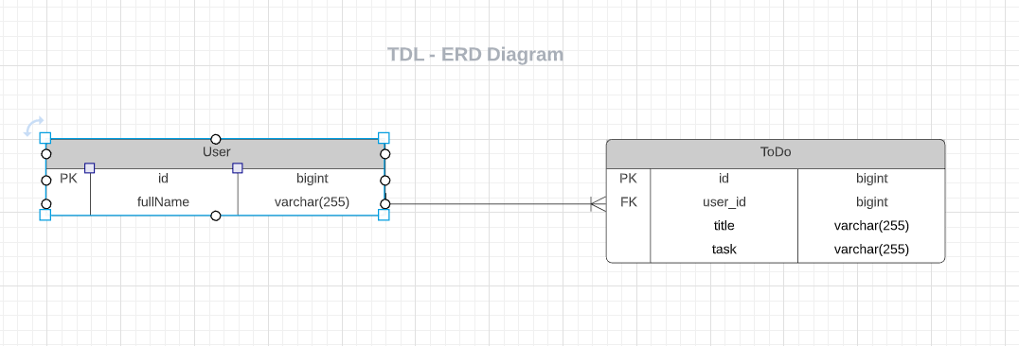
ERD

Slide 7
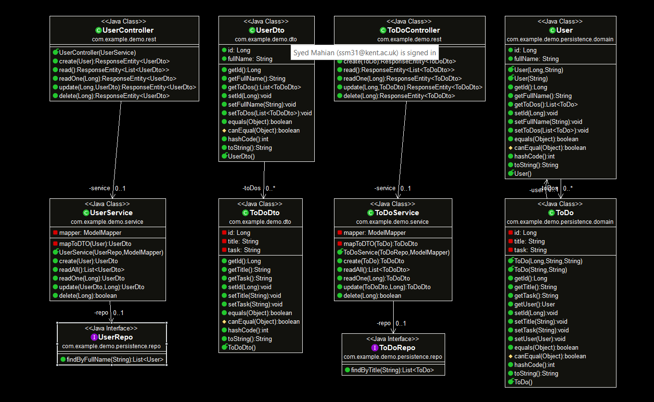
UML Diagram

Slide 8
Consultant’s Journey
Agile & Project Management
Database & Cloud Fundabmentals
Programming & Testing Fundamentals
CI & Build Tools

Slide 9
Technologies Used
Version Control System : Git
SourceCode Management: GitHub
KabanBoard: Jira
Database Management System: SQL
Back-End Programming Language: Java
Front-End Programming Language: HTML, CSS, Javascript.
Build Tool: Maven
Unit Testing: JUnit

Slide 10
Application Demonstration

Slide 11
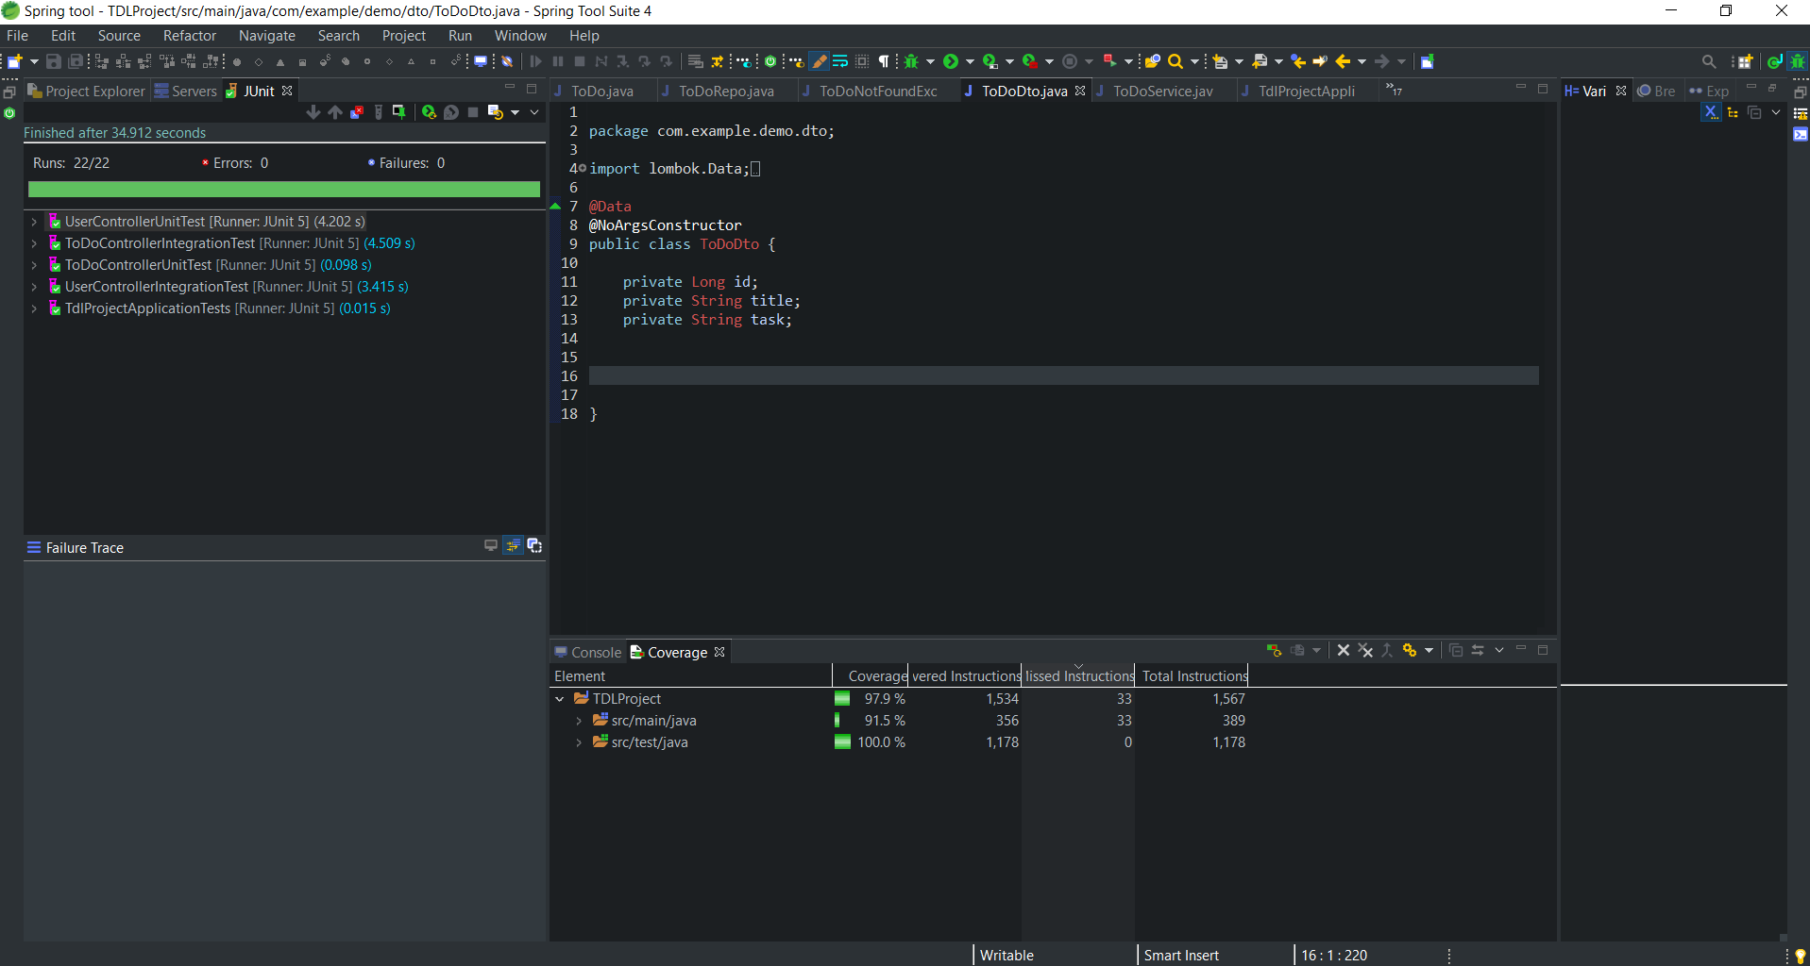
Testing:

Slide 12
Sprint Review
Completed Web-App with working front and back end.
Testing at over 80%
Gained practical experience of developing a program.
Able to use project management skills

Slide 13
Retrospective: Negative
Improper use of Git for Version control.
Not being able to implement Selenium Testing
Files deleted: 1. MoSCoW, ERD, UML Diagram, . Jar file

Slide 14
Any Questions?

